Slide 1
Data Analytics for HealthCare
Data flow from On Prem SQL Server Database to Snowflake
Rohan Chauhan
Feb-2024

Slide 2
Agenda
Overview
Cloud Computing - an Overview
Ingestion, Store, and Process
Microsoft Azure Storage
Microsoft Azure Data Factory
Snowflake
Project for Data Analytics for HealthCare
VARIAN CONFIDENTIAL – FOR INTERNAL USE ONLY

Slide 3
Cloud Computing – An Overview

Slide 4



We are in a new era of computing…
PC Era Internet Era Cloud Era
Connecting servers, PCs, and networks
A PC on every desktop
On-demand productivity and hybrid flexibility

Slide 5

Cloud Computing
“Cloud computing refers to the on-demand provision of computational resources (data, software) via a computer network, rather than from a local computer”
“Cloud computing is the on-demand availability of computer system resources, data storage and compute power, without direct active management by the user”
Large clouds often have functions distributed over multiple locations, each location being a data center
“Pay-as-you-go" model i.e. no upfront Investment which can help in reducing capital expenses but may also lead to unexpected operating expenses for unaware users
Source: Wikipedia

Slide 6
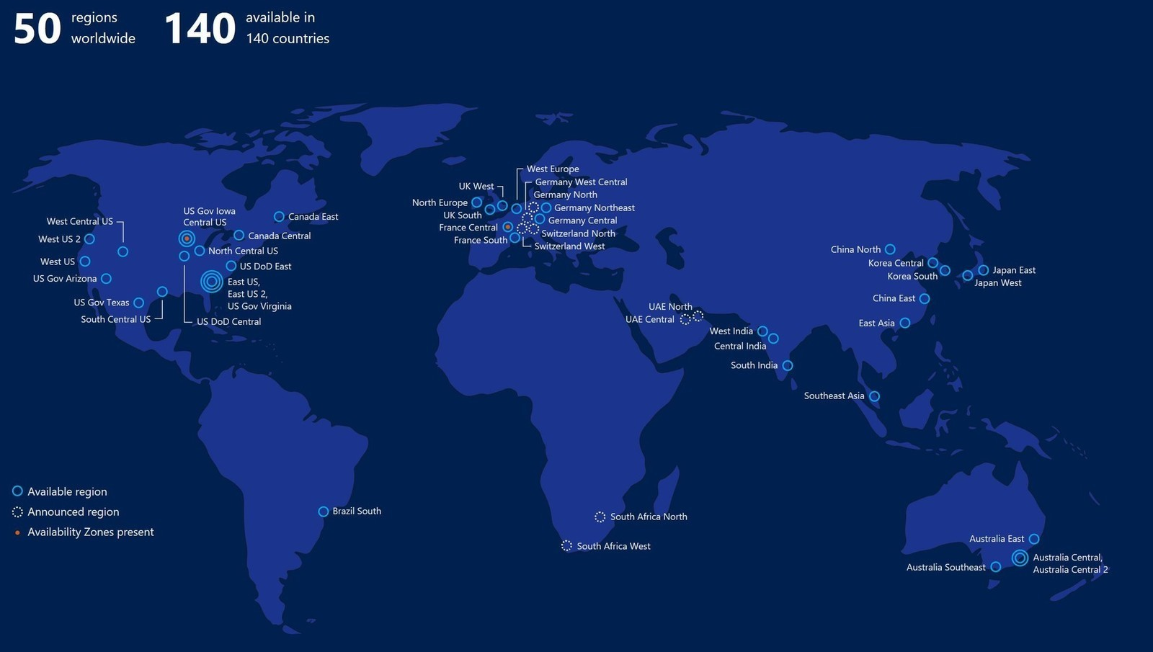
Global Infrastructure

Slide 7
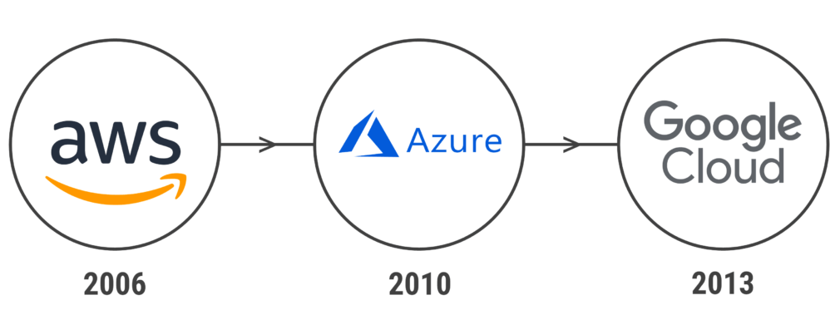
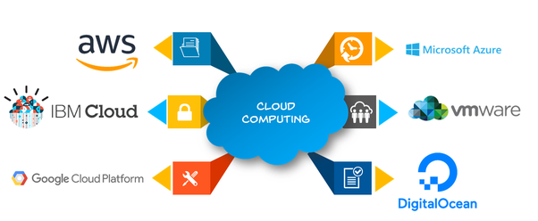
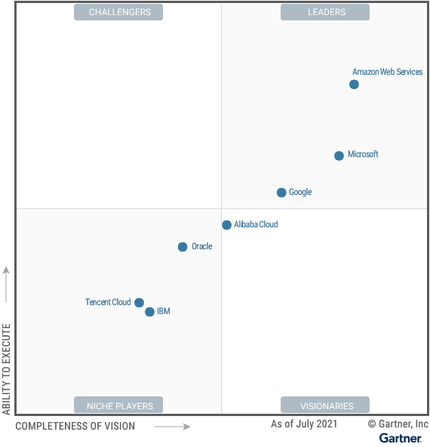
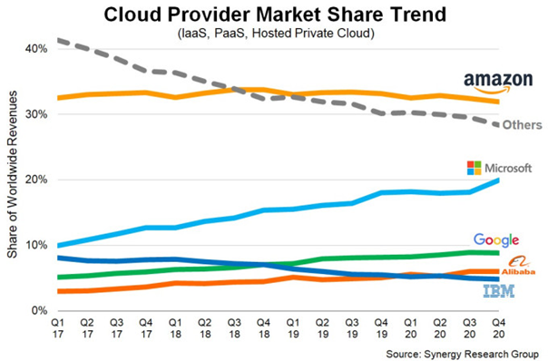
Magic Quadrant for Cloud Infrastructure and Platform Services

Slide 8









Cloud Computing Models

Slide 9
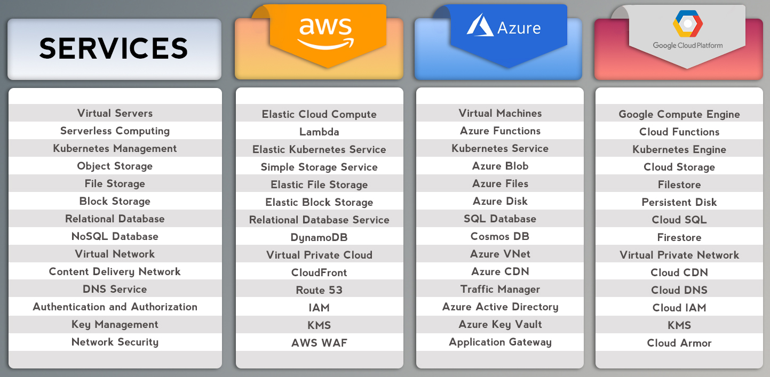
AWS, Azure, GCP Services…Snapshot!

Slide 10
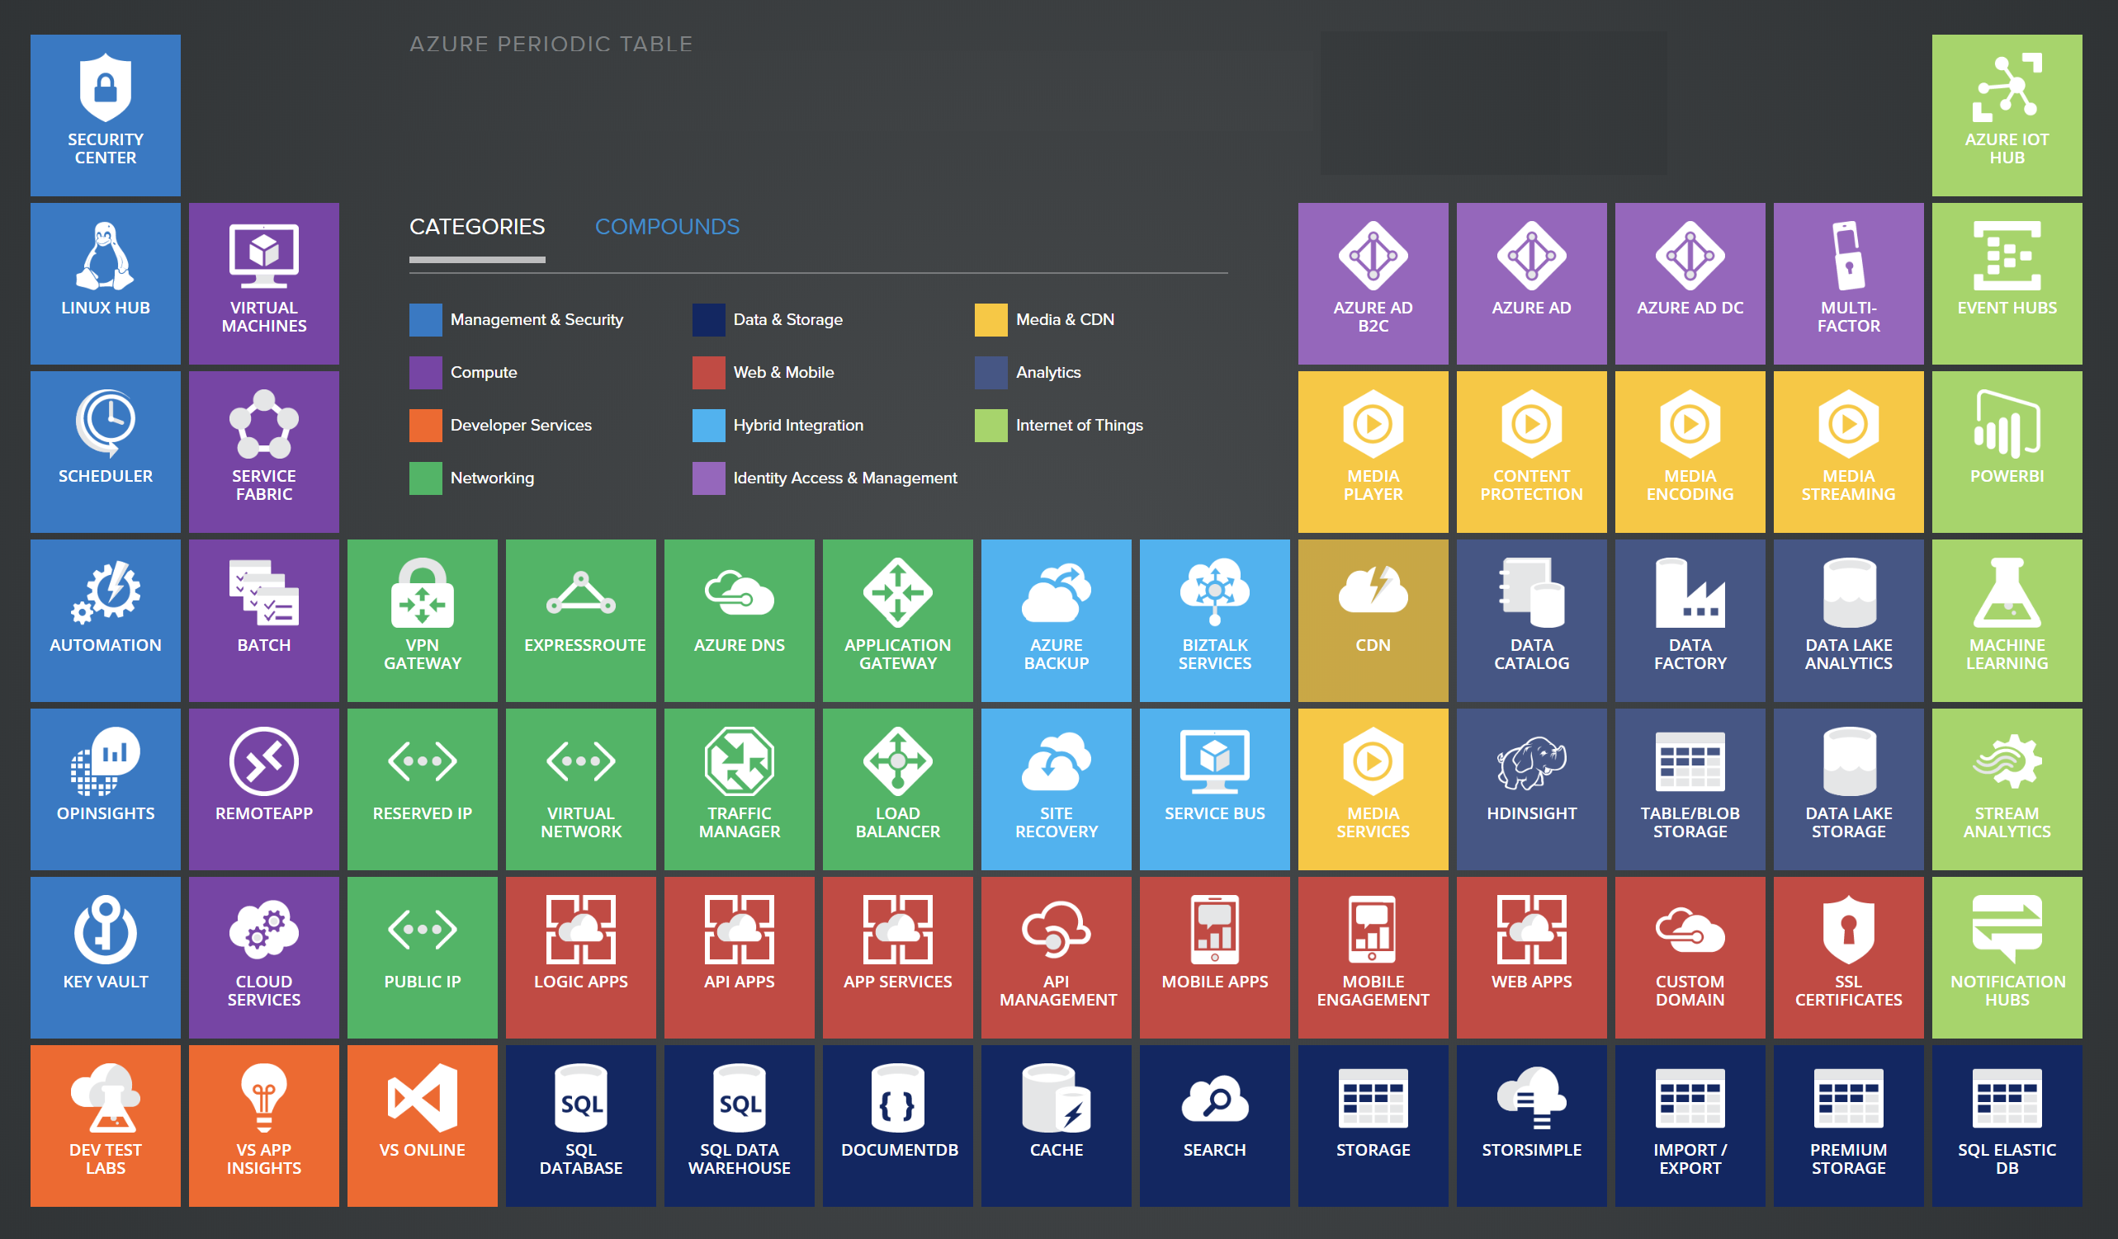
Microsoft Azure – 200+ Services…

Slide 11
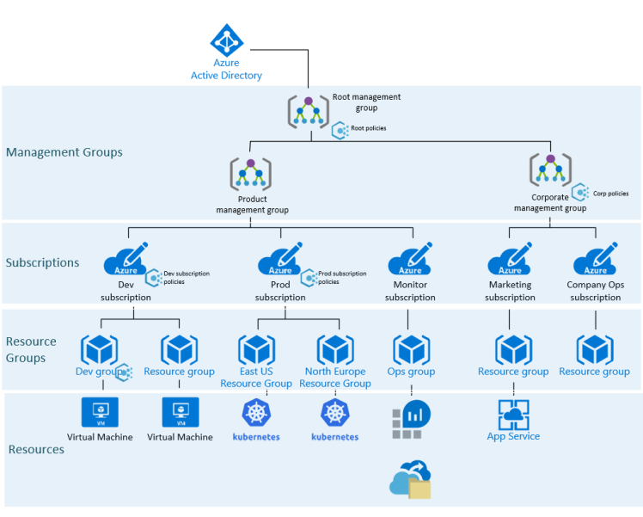
Subscription, Resource Group, and Resources
Management Groups provides a way to manage access, policies, and compliance across multiple subscriptions.
Subscriptions are Azure’s way to associate user accounts and resources. Azure Admin can provide subscriptions with policies, limits or quotas on what users can create and use. Costs are managed within Subscriptions.
Resource Groups is a logical container for a set of resources that are managed together. Typically, resources within a resource group have the same lifecycle, meaning they are often created or managed as a single unit.
Resources are instances of the service, such as storage or a database, or data factory etc.

Slide 12
Microsoft Azure - Storage

Slide 13



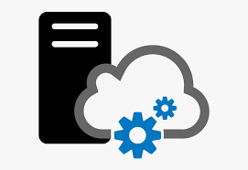

Azure Storage – Solution for Modern Data storage Scenarios
High Availability and Durability
Data replication across data centers, zones and regions
Redundancy ensures that data is safe in the event of transient hardware failures. There is an option to replicate data across data centers or geographical regions for additional protection from local catastrophe or natural disaster. Data replication ensure that data remains highly available in the event of an unexpected outage.
Security
Encryption and fine-grained access control services of your data
All data written to an Azure storage account is encrypted by the service. Azure Storage provides fine-grained control over who has access to your data.
Scalability
High performance and scalability for high performant applications
Azure Storage is designed to be massively scalable to meet the data storage and performance needs of today's applications.
Managed
Microsoft Azure handles all of the hardware maintenance, updates, and critical issues.
Accessible
Data in Azure Storage is accessible from anywhere in the world over HTTP or HTTPS.
Microsoft provides client libraries for Azure Storage in a variety of languages, including .NET, Java, Node.js, Python, PHP, Ruby, Go, and others, as well as a mature REST API.
Azure Storage supports scripting in Azure PowerShell or Azure CLI.
Azure portal and Azure Storage Explorer offer easy visual solutions for working with data.

Slide 14




Azure Storage – Data Services
Blob Storage
File Storage
Queue Storage
Table Storage
Ideal for storing large unstructured files are stored, and can be accessed using the URL over HTTP/HTTPs
A massively scalable object store for text and binary data. Also includes support for big data analytics through Data Lake Storage Gen2.
Ideal for storing highly accessible files accessed over SMB, allowing concurrent access from multiple VM’s
Managed file shares for cloud or on-premises deployments
Ideal for storing millions of messages in the queue for asynchronous processing
A messaging store for reliable messaging between application components.
Ideal for storing structured NoSQL data with no need to write complex queries
A NoSQL store for Schema less storage of structured data.

Slide 15
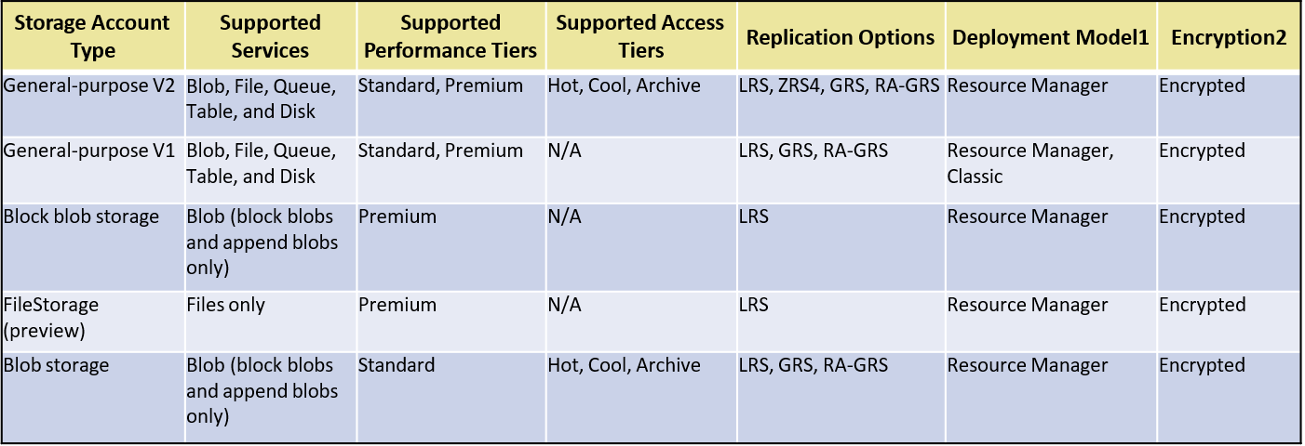
Azure Storage – Securing Storage Account
Locally redundant storage (LRS) copies your data synchronously three times within a single physical location in the primary region
Zone-redundant storage (ZRS) copies your data synchronously across three Azure availability zones in the primary region
Geo-redundant storage (GRS) copies your data synchronously three times within a single physical location in the primary region & secondary region using LRS; Geo-zone-redundant storage (GZRS) copies your data synchronously across three Azure availability zones in the primary region using ZRS

Slide 16
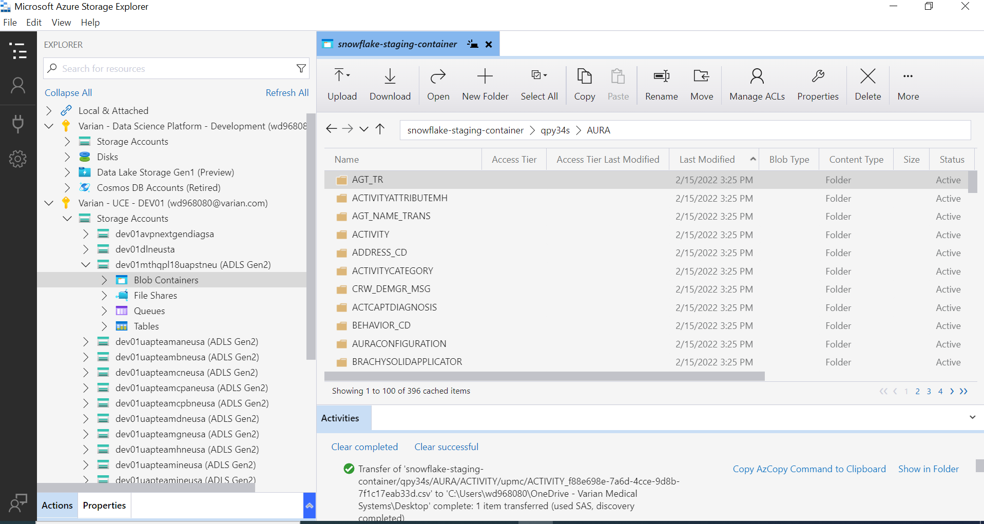
Azure Storage – Snapshot!

Slide 17
Microsoft Azure - Data Factory

Slide 18
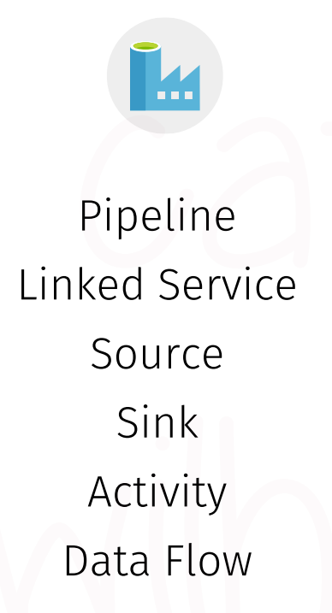
Component of Azure Data Factory v2

Slide 19
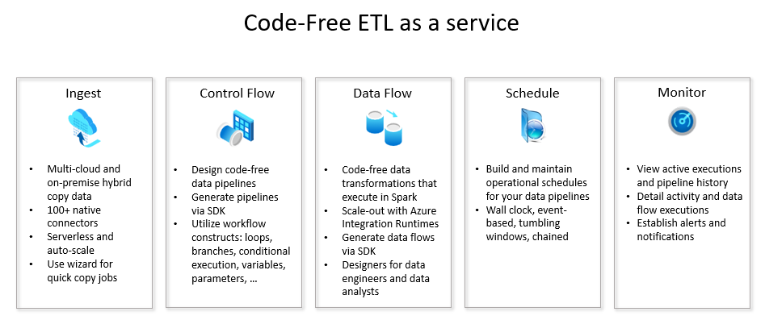
Azure Data Factory
Azure Data Factory is a managed cloud service build complex hybrid extract-transform-load (ETL), extract-load-transform (ELT)

Slide 20
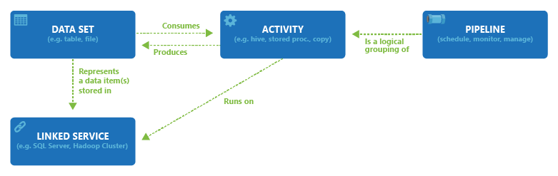

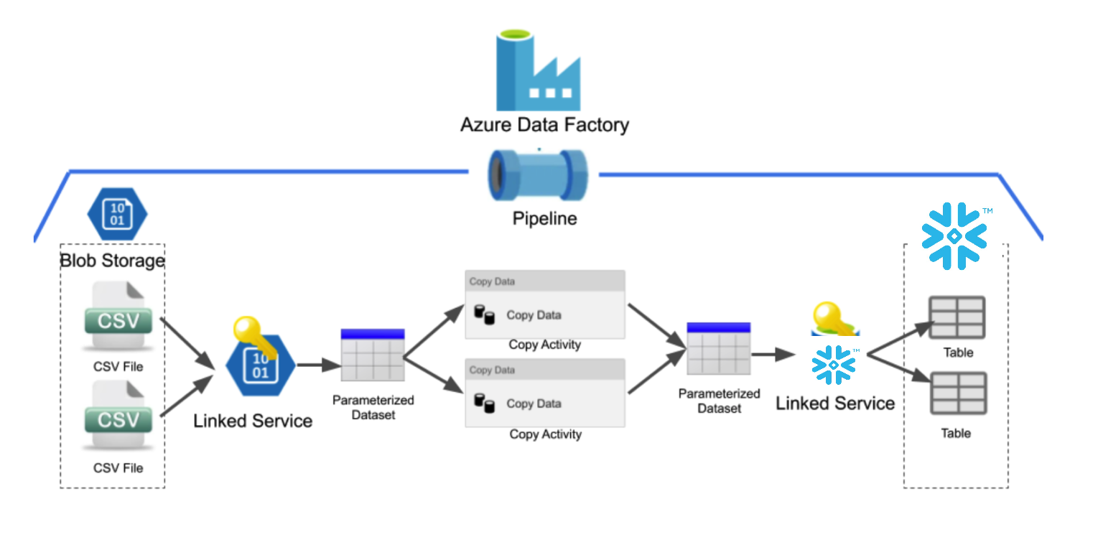
Pipeline, Activity, Dataset, Linked Services
Logical View
Diagrammatic View
Pipeline is a logical grouping of activities that together perform a task. Each pipeline run has a unique pipeline run ID i.e. GUID that uniquely defines that pipeline execution
Activities in a pipeline define actions to perform on data
Dataset is a named view of data that simply points or references the data
Linked Service to link data store

Slide 21
Integration Runtime (IR)
The Integration Runtime (IR) is the compute infrastructure used by Azure Data Factory pipelines and provide the data integration capabilities across different network environments
Data Flow: Execute a data flow in a managed Azure compute environment
Data movement: Copy data across data stores in a public or private networks and support for built-in connectors, format conversion, column mapping, and performant and scalable data transfer.
Activity dispatch: Dispatch and monitor transformation activities running on a variety of compute services such as Azure Databricks, Azure HDInsight, ML Studio (classic), Azure SQL Database, SQL Server, and more.
SSIS package execution: Natively execute SQL Server Integration Services (SSIS) packages in a managed Azure compute environment.
Integration runtime is a bridge between Activities and Linked Services. It provides the Compute environment where the activity is either run directly or dispatched
Integration runtime allows the activity to be performed in the closest possible region to the target data store or compute service to maximize performance while also allowing flexibility to meet security and compliance requirements
Types of IR
Azure: Run copy activities between cloud data stores
Self-Hosted: Running copy activity between a cloud data stores and a data store in private network.
Azure-SSIS: Lift and shift of existing SSIS and their execution

Slide 22
Triggers & Their Types
Execution of a pipeline by using a trigger
Schedule Trigger
Tumbling Window Trigger
Event Based Trigger
A trigger that invokes a pipeline on a wall-clock schedule
For example:
Intervals like "weekly" or "Monday at 5:00 PM and Thursday at 9:00 PM."
A trigger that operates on a periodic interval
For example:
Run every 15 minutes; Run at 5:15 AM, 5:45 AM, 5:15 PM, and 5:45 PM every day.
There are two types of event-based trigger that responds to an event:
Storage event trigger runs a pipeline against events happening in a Storage account, such as the arrival of a file, or the deletion of a file in Azure Blob Storage account
Custom event trigger processes and handles custom articles in Event Grid

Slide 23
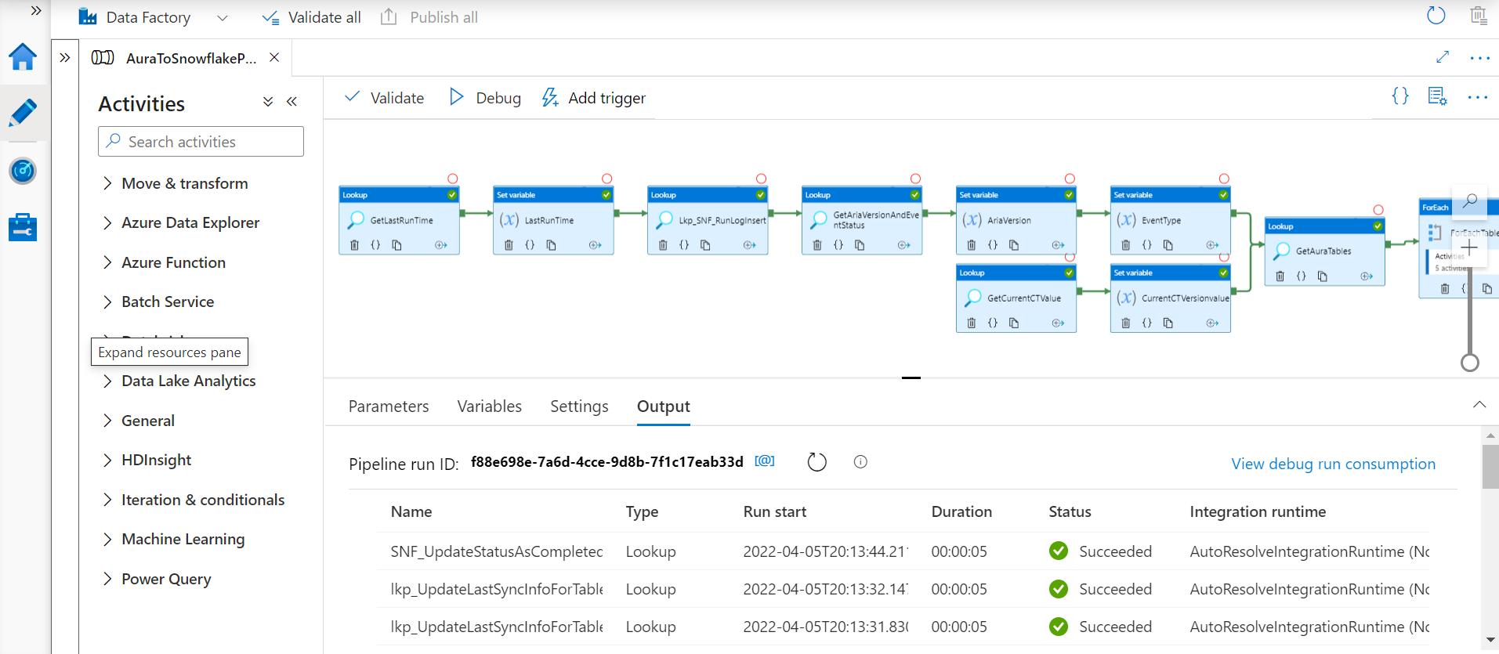
Azure Data Factory – Snapshot!

Slide 24
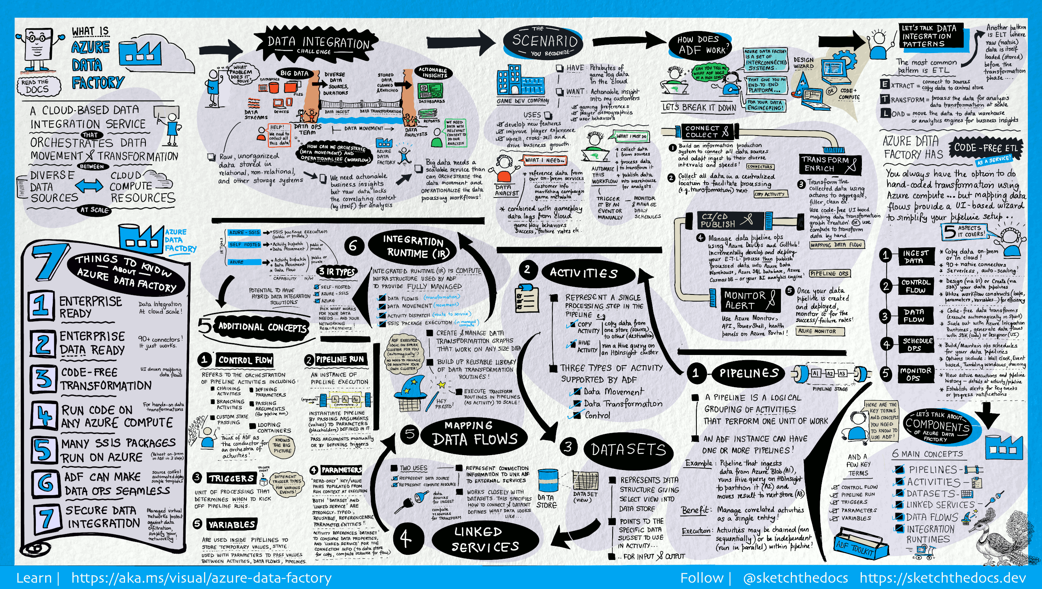

Slide 25
SnowFlake

Slide 26
Snowflake
Getting Started with Snowflake - Zero to Snowflake
Single place for data
Scale & concurrency
Zero management
Instant, live data sharing
Unique architecture: Multi-cluster, shared data

Slide 27
Zero management
Load data and run queries, we do all the rest
Zero infrastructure and admin costs
Secure and highly available
Fully managed with no knobs or tuning required
No indexes, distribution keys, partitioning, or vacuuming

Slide 28
All of your data
IoT
Structured and semi-structured data (JSON, XML, Avro)
Centralized storage of data, accessible by any user and application
Multi-petabyte scale
Web
Enterprise apps
3rd party apps
Corporate
Mobile

Slide 29
All of your users
Up to 200x faster than solutions not built for the cloud
Maintains a consistent SLA – resources grow and shrink automatically
Loading data does not impact query performance
Multiple groups access data at the same time with no performance degradation
Supports an unlimited number of simultaneous users
Predictive analytics
Data exploration
Data-driven applications
BI/Reporting
Diverse applications

Slide 30
Snowflake’s Multi-cluster, shared data architecture
Transactions
Security
Management
Ad hoc analytics
Service
Compute
Centralized storage
Storage
Development
Loading
Metadata
Optimization
Instant, automatic scalability & elasticity

Slide 31
Snowflake architecture: Storage and compute
Storage separated from compute Automatically grows without adding nodes. Never run out of space.
Marketing
Finance
Resize compute instantly Scale up/down depending on the business needs right now or turn off when not in use.
Loading / ELT
Dev / Test
Multiple clusters access data without contention ETL, reporting, data science, and applications all running at the same time without performance impact.

Slide 32
Snowflake architecture: Global Services
Management
Optimization
Security
Availability
Transactions
Metadata
Centralized management
Separate metadata from storage and compute
Marketing
Finance
Full transactional consistency across entire system (ACID)
Loading / ELT
Dev / Test
As soon as data commits, each cluster sees the newest version

Slide 33

Real-World use case
Interactive Dashboard
50% < 1s 85% < 2s 95% < 5s
Continuous Loading (4TB/day)
S3
<5min SLA
Virtual Warehouse
Auto Scale – X-Large x 5
Virtual Warehouse
Medium
Reporting (Segmented)
ETL & Maintenance
Prod DB
Virtual Warehouse
2X-Large
Virtual Warehouse
Large
4 trillion rows 3+ petabyte raw aata
8x compression ratio
25M micro partitions

Slide 34
Adaptive caching
Metadata Metadata cached for fast access during query planning
Data Active working set transparently cached on virtual warehouse SSD
Cloud Services
Virtual Warehouse(s)
Query results Results sets cached for reuse without requiring compute (e.g., static dashboard queries)
Database Storage

Slide 35
Virtual Private Snowflake
Blob Storage
Customer VPC
Customer Dedicated Snowflake VPC
Encrypted Communication
Snowflake Load Balancer
Cloud Services
Virtual Warehouses
Maintenance and Services

Slide 36




Virtual Private Snowflake
Region
Customer Dedicated Virtual Environment
VPS Secure Pod
Customer Dedicated Virtual Instances
Customer Environment
Encrypted Everywhere
Load Balancer
Cloud Services
Metadata Store
Virtual Warehouses
Blob Storage
Customer Managed Keys

Slide 37
Fast Elasticity
Pay for only what you use, at cloud economies of scale
Snowflake uses the cloud to enable elasticity
Traditional databases are inflexible
On-prem
$10,000 TB/yr
Usage Varies
Cloud data warehouse
$1000 TB/yr
Snowflake
$360 TB/yr
Pay for only what you use with no overprovisioning
Eliminate overbuy
Scale compute up and down, transparently and automatically
No need for capacity planning, make capacity decisions on the fly
Pay only for what you use
Cloud economies of scale

Slide 38


Data warehouse built for the cloud
Complete SQL Database
Zero Management
All of Your Data
All of Your Users
Pay Only for What You Use
Live Data Sharing

Slide 39
The Impact of Snowflake
Unlimited Concurrency
Fast Elasticity
High Availability
Comprehensive Security
Delivering customized experience requires a great deal of analytics. Now that the entire team has their own compute resources, anyone can finally ask any question at any time.
The data science team is now empowered with infinite scalability. Combined with pay as you go billing, they can answer every question quickly, at dramatically lower cost.
With built-in failover from US-West to US-East, Capital One has ensured their customer data will always be available, accurate, and ready for analysis.
Snowflake’s built in security features have delivered the safety that Capital One demands and that their customers deserve.

Slide 40
What companies need from their database is straightforward
Achieving it with current technologies is not
Unlimited Concurrency
Fast Elasticity
High Availability
Comprehensive Security
Thousands of users and hundreds of applications fighting for limited resources
Not able to scale elastically or fluidly, high cost to scale
Prohibitively expensive and difficult to orchestrate failover for true HA
Constant updates to keep up with the latest regulations and best practices

Slide 41
The Impact of Database Problems at Capital One
Slow ad-hoc queries and dashboards
Couldn’t meet the analytics needs of the business
System downtime
Unable to innovate and scale due to complexity
Unlimited Concurrency
Fast Elasticity
High Availability
Comprehensive Security
With massive concurrency across dozens of business units, database performance was strained to the maximum, slowing analysis times and limiting data to a few.
Data scientists were unable to scale the service to larger queries, significantly inhibiting their ability to find new ways to deliver personalized experiences.
Without a way to failover between regions, the existing solution lacked a critical capability in delivering and protecting data.
Without the built-in security they needed, Capital One had to painstakingly secure their data warehouse from scratch. Changes or updates had significant implications.

Slide 42
The Impact of Snowflake At capital one
Improved productivity and agility
New business insights
Performance and access always remain consistent
Peace of mind for customers and employees
Unlimited Concurrency
Fast Elasticity
High Availability
Comprehensive Security
Delivering customized experience requires a great deal of analytics. Now that the entire team has their own compute resources, anyone can finally ask any question at any time.
The data science team is now empowered with infinite scalability. Combined with pay as you go billing, they can answer every question quickly, at dramatically lower cost.
With built-in failover from US-West to US-East, Capital One has ensured their customer data will always be available, accurate, and ready for analysis.
Snowflake’s built in security features have delivered the safety that Capital One demands and that their customers deserve.

Slide 43
LEGACY data landscape
Data Sources
BI / Analytics
ETL
OLTP Databases
EDW
Datamarts
Enterprise Applications
Third-Party
Web Apps
Other
Data Lake
or Hadoop

Slide 44
Modern data landscape
Data Sources
BI / Analytics
ETL or ETL
OLTP Databases
EDW
Logical Datamarts
Enterprise Applications
Third-Party
Web Apps
Other
Data Lake
or Hadoop

Slide 45
What customers want
Performance
Concurrency
Simplicity
200x
Multi petabyte-scale, up to 200x faster performance and 1/10th the cost.
Multiple groups access data simultaneously with no performance degradation.
Fully managed with a pay-as-you-go model. Works on any data.

Slide 46

A new architecture for data warehousing
Multi-cluster, shared data, in the cloud
Traditional Architectures
Snowflake
Shared-disk
Shared-nothing
Multi-cluster, shared data
Shared storage
Single cluster
Decentralized, local storage
Single cluster
Centralized, scale-out storage
Multiple, independent compute clusters

Slide 47



SECURE BY DESIGN
Authentication
Access control
Data encryption
External validation
Embedded multi-factor authentication
Federated authentication available
Role-based access control model
Granular privileges on all objects & actions
All data encrypted, always, end-to-end
Encryption keys managed automatically
Certified against enterprise-class requirements

Slide 48

Modernizing data warehouse
Scenario
Pain Points
Entire company on GCP with business units using Snowflake
30 Node Hadoop Cluster and 46 node Vertica Cluster on premise
Extremely security focused with requirements for PCI
Using Looker and Spark
Teams wanted autonomy, but didn’t have resources to support
Vertica requires constant maintenance and suffers from outages
Performance suffers during time of intense reporting
Moving to BigQuery would create a new set of problems, Redshift had the same problems
Getting data from partners is painful and slow
REF/ TXN
Source
Hadoop
Vertica
Multiple datamarts
REF/ TXN
Source
In database
transformations
Users, tools, website
directly query data
Snowflake Value
Map their current data model easily and quickly with the same SQL
SaaS service with zero downtime
Separate Warehouses for each team – zero contention and full independence on the same data

Slide 49
How Do We Do It? A Brand New Architecture
Cloud Services
Management
Optimization
Security
Availability
Transactions
Metadata
Semi-structured data
Data Science (L)
Data Transformation (M)
Semi-structured data
Structured data
SQL Queries (S)
BI/Reporting Multi-Cluster (M)
Structured data
Multi-Tenant Snowflake Deployment
Flexible Cloud Storage For All Kinds of Data
Unlimited Compute Clusters to Serve Every Use
Easy-to-use Service with No Management
Notes:
Snowflake was built with a brand new architecture.
First, we started with flexible cloud storage, giving you the ability to store unlimited amounts of structured and semi-structured data.
Then, on top of that storage we built the services and SQL you need to run your data warehouse without any management. Snowflake handles the optimization, security and availability, etc, for you.
Last, we created flexible compute nodes, called “Virtual Warehouses”, for you to execute your queries and transformation on. These can be created at any time with SQL commands, or within the Snowflake UI. If you have different workloads with different needs, you can size your warehouses to fit. You can even create “multi cluster warehouses” that will scale automatically to high numbers of concurrent queries, providing “more lanes on the highway”. Best of all, you can turn off any of these data warehouses at any time so you only pay for what you use.

Slide 50
Project Details

Slide 51
Thank you

